Slide 1

SMART IRRIGATION SYSTEM USING IOT
BATCH NO: B11
SOWMYA.J (154G1A0584)
SAI SHARADA.G (154G1A0576)
SREEJA.L.S (154G1A0587)
WASEEM AKRAM.M (154G1A05B0)
Project Guide: Mr.Y.Ramesh M.Tech.,. Assistant Professor,CSE
Srinivasa Ramanujan Institute of Technology
Department of Computer Science & Engineering

Slide 2
PREVIOUS REVIEW COMMENTS
What if the rainfall started when we already watered the plants?
Uneven surface areas in the field may lead to improper wetting of land.

Slide 3
Contents
Design
Implementation
References

Slide 4
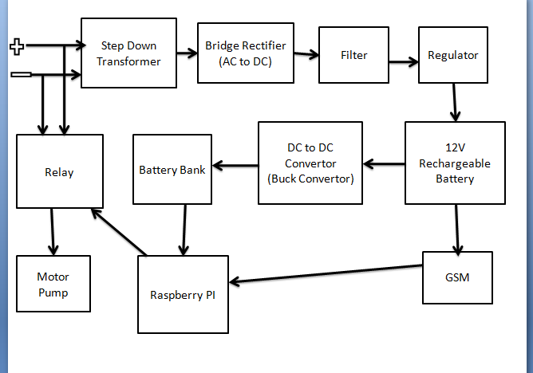
Design

Slide 5
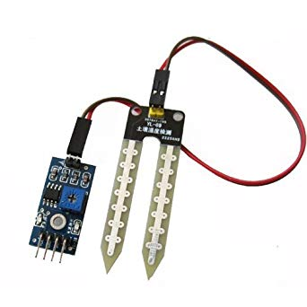
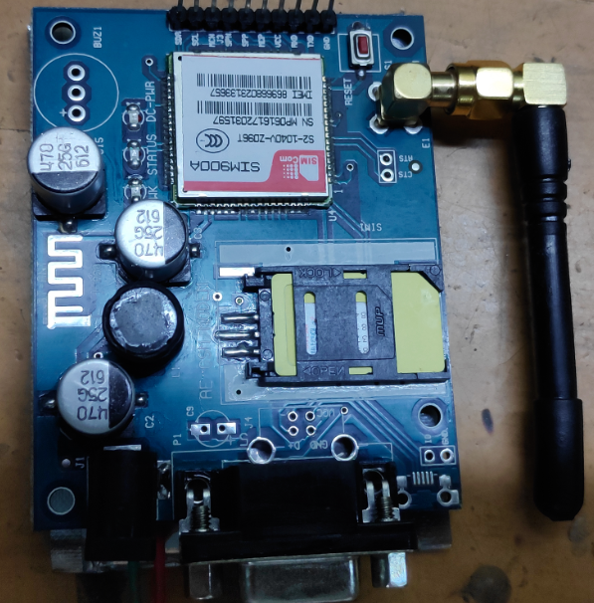
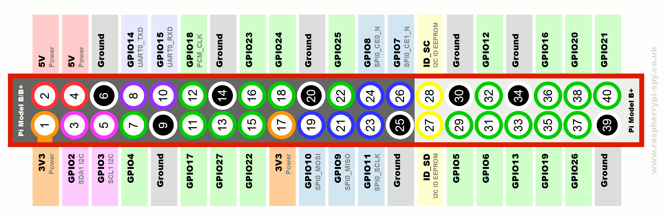
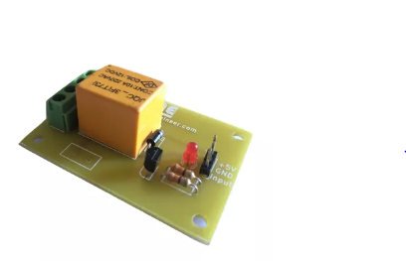
Detailed Diagram of Connections
SOIL MOISTURE SENSOR
GSM MODULE
Ground-
Power Supply-
Data -
TX-
RELAY
RASPBERRY PI 3
RX-

Slide 6

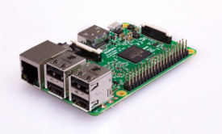



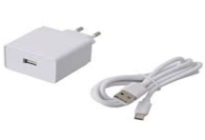

Implementation
Installing the Raspbian OS
REQUIREMENTS
RASPBERRY PI 3 : Single Board Computer .
SD CARD : An 8GB class 4 SD card.
DISPLAY : PC or TV.
KEYBOARD & MOUSE : A standard USB keyboard and mouse.
POWER SUPPLY : Use a 5V micro USB power supply to power your Raspberry Pi. Be careful that whatever power supply you use outputs at least 5V; insufficient power will cause Pi to behave unexpectedly.
INTERNET CONNECTION : To update or download software, connect Raspberry Pi to the internet .

Slide 7
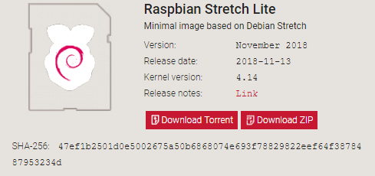
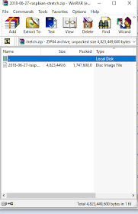
Download Zip File & Extract it.

Slide 8
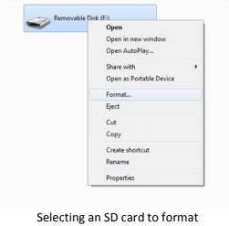
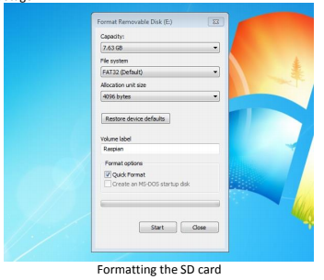
Insert SD Card & Format it

Slide 9
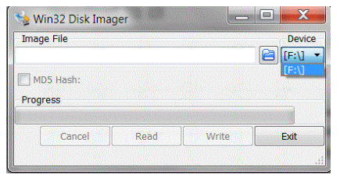
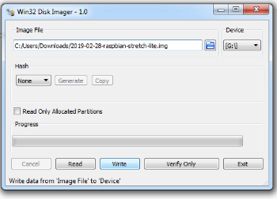
Open Win32 Disk Imager & Write
Download the Win32DiskImager utility to write the image file to the sd card.

Slide 10
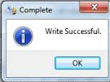
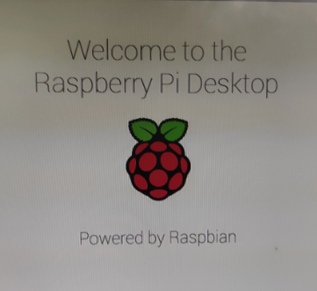
Write Successful &Welcome Screen

Slide 11
PYTHON CODE
if __name__ == "__main__":
while True:
soil = GPIO.input(SOIL_MOISTURE)
print("Soil :" + str(soil))
payload = build_payload(VARIABLE_LABEL_1, soil)
post_request(payload)
mode = get_var(DEVICE_LABEL, VARIABLE_LABEL_3)
print(mode)
mode = int(mode)
print("Mode :{}".format(mode))
if mode == 1:
if soil == 1:
GPIO.output(PUMP, GPIO.HIGH)
payload = build_payload(VARIABLE_LABEL_5, 1)
post_request(payload)
else:
GPIO.output(PUMP, GPIO.LOW)
payload = build_payload(VARIABLE_LABEL_5, 0)
post_request(payload)

Slide 12
Continued..
elif mode == 0:
control = get_var(DEVICE_LABEL, VARIABLE_LABEL_4)
print("Control :{}".format(control))
control = int(control)
if control == 1:
GPIO.output(PUMP, GPIO.HIGH)
payload = build_payload(VARIABLE_LABEL_5, 1)
post_request(payload)
elif control == 0:
GPIO.output(PUMP, GPIO.LOW)
payload = build_payload(VARIABLE_LABEL_5, 0)
post_request(payload)
switch = GPIO.input(SWITCH)
if switch == 1:
print("Power Failure");
GPIO.output(RELAY, GPIO.LOW)
ser.write('AT+CMGS="+918919745605"\r')
payload = build_payload(VARIABLE_LABEL_2, 1)
post_request(payload)
sleep(1)

Slide 13
Continued..
msg = "Power OFF :from GSM Agri"
print("Sending SMS with status info:" + msg)
ser.write(msg + chr(26))
sleep(1)
payload = build_payload(VARIABLE_LABEL_2, 1)
post_request(payload)
else:
print("Power ON Condition")
GPIO.output(RELAY, GPIO.HIGH)
payload = build_payload(VARIABLE_LABEL_2, 0)
post_request(payload)
sleep(1)

Slide 14
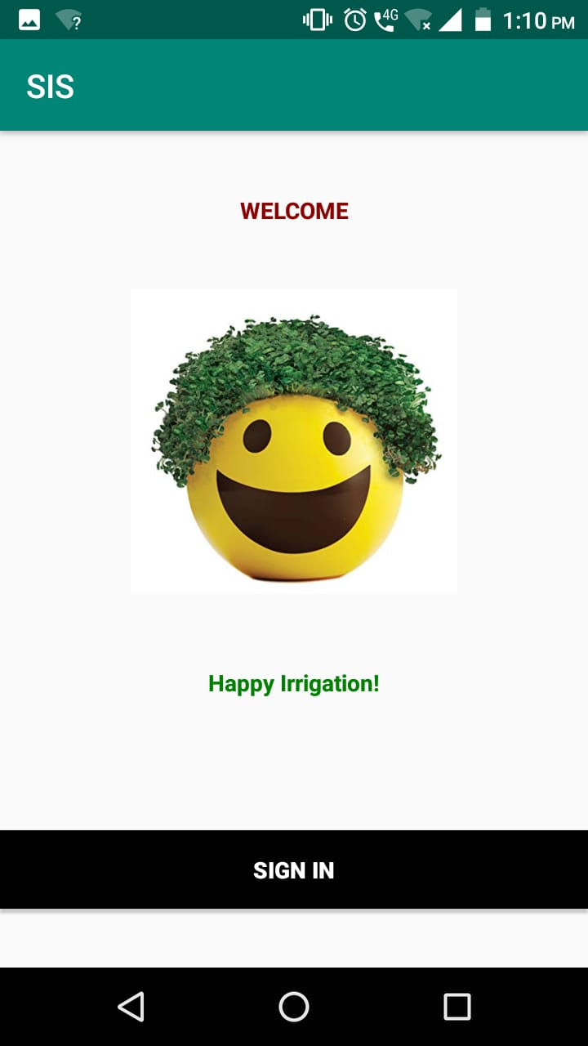


UI SCREENS

Slide 15
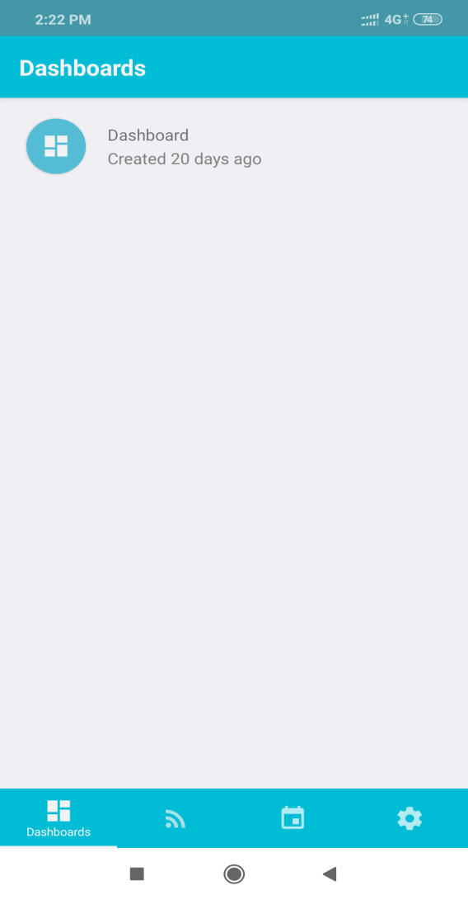
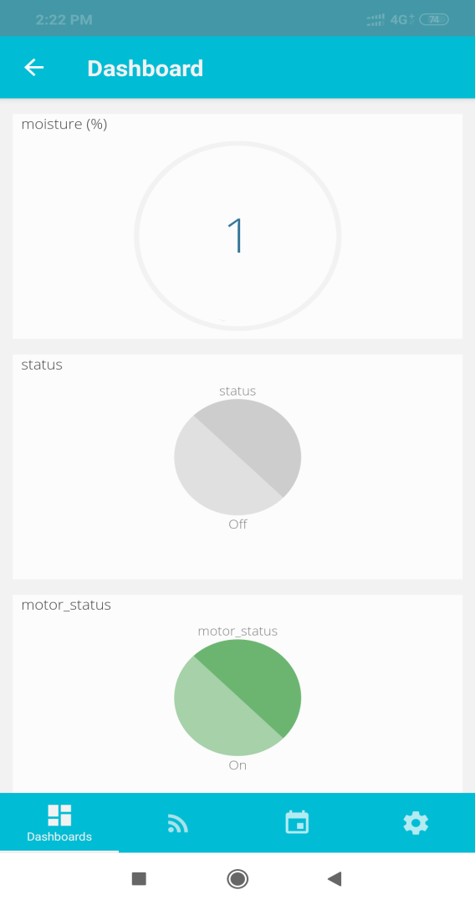
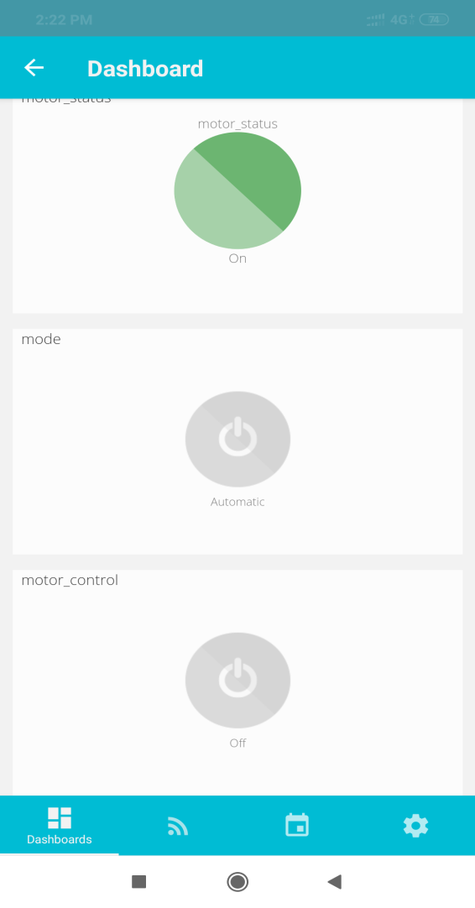
Continued..

Slide 16
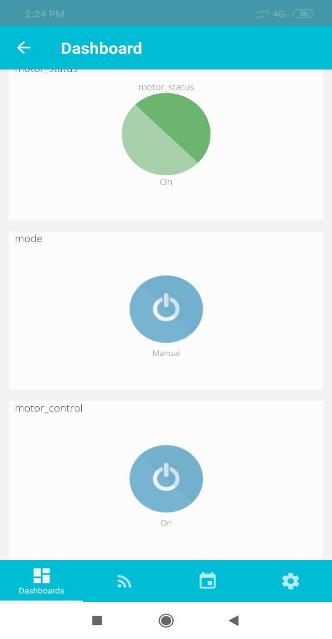
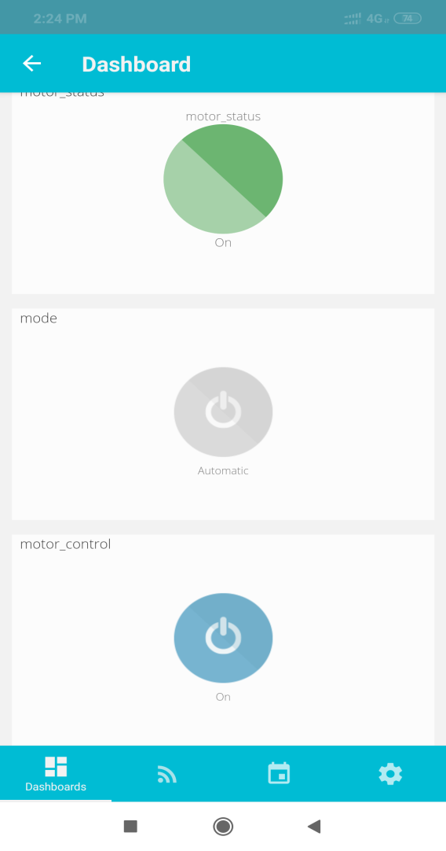
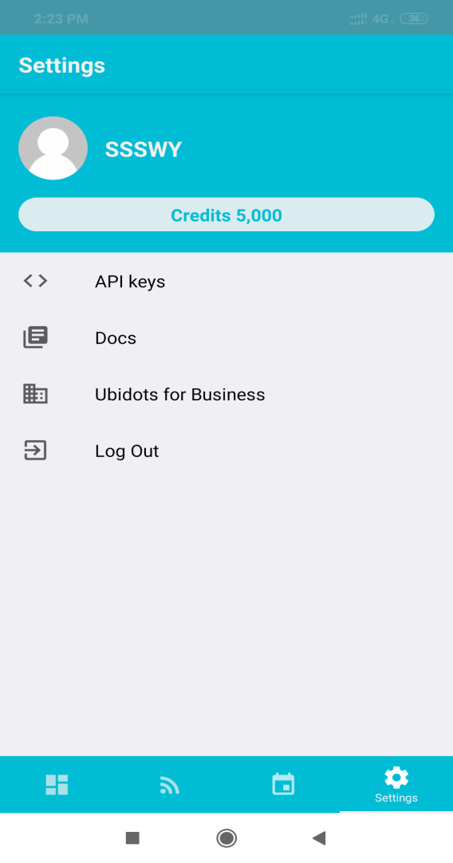
Continued..

Slide 17
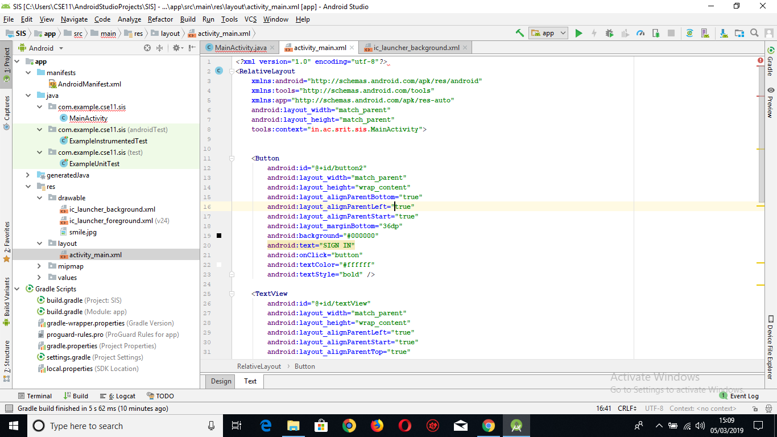
XML CODE

Slide 18
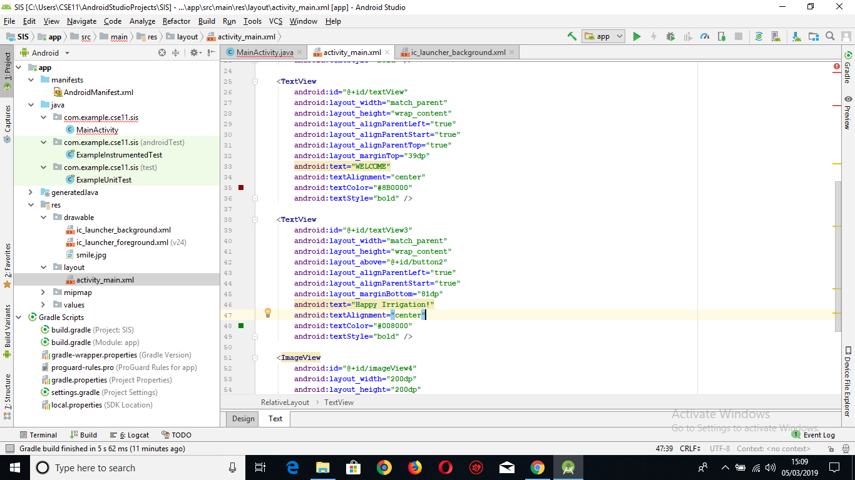
XML CODE

Slide 19
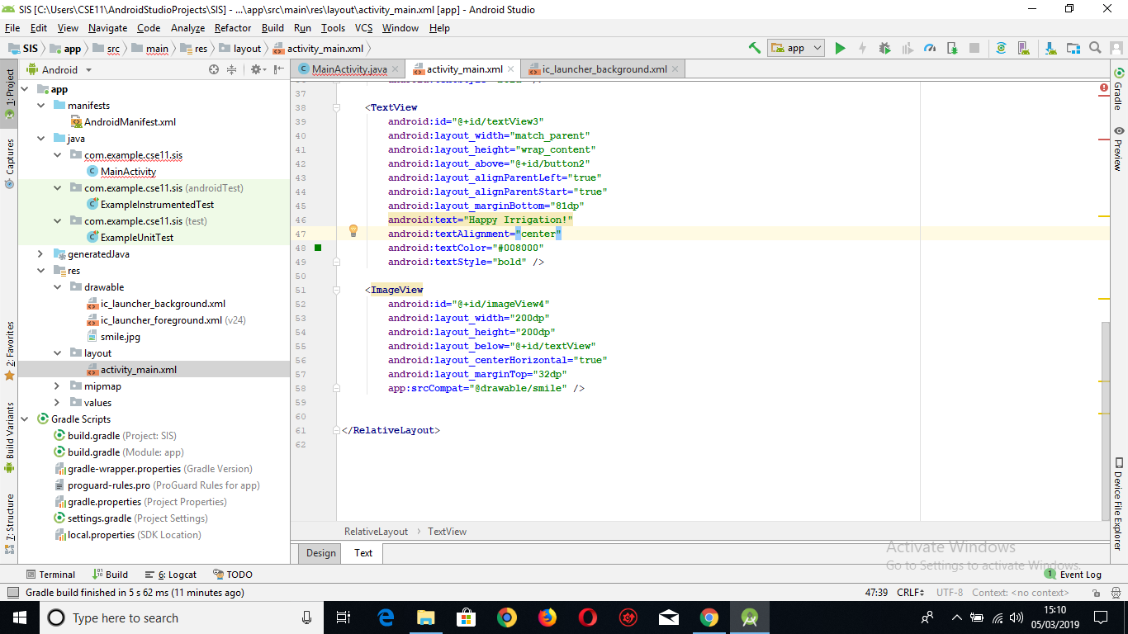
XML CODE

Slide 20
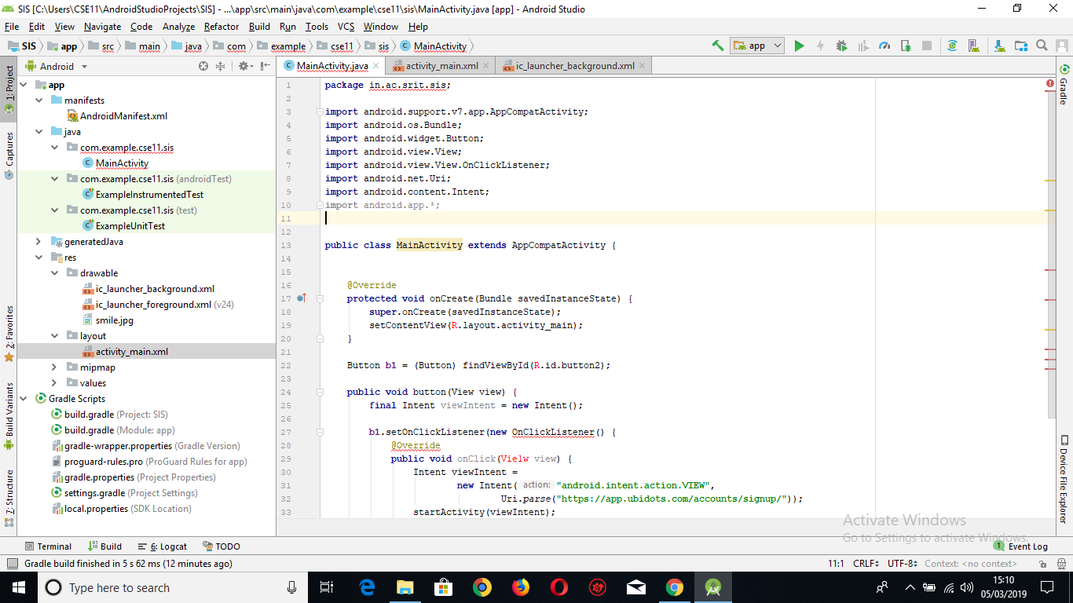
JAVA CODE

Slide 21
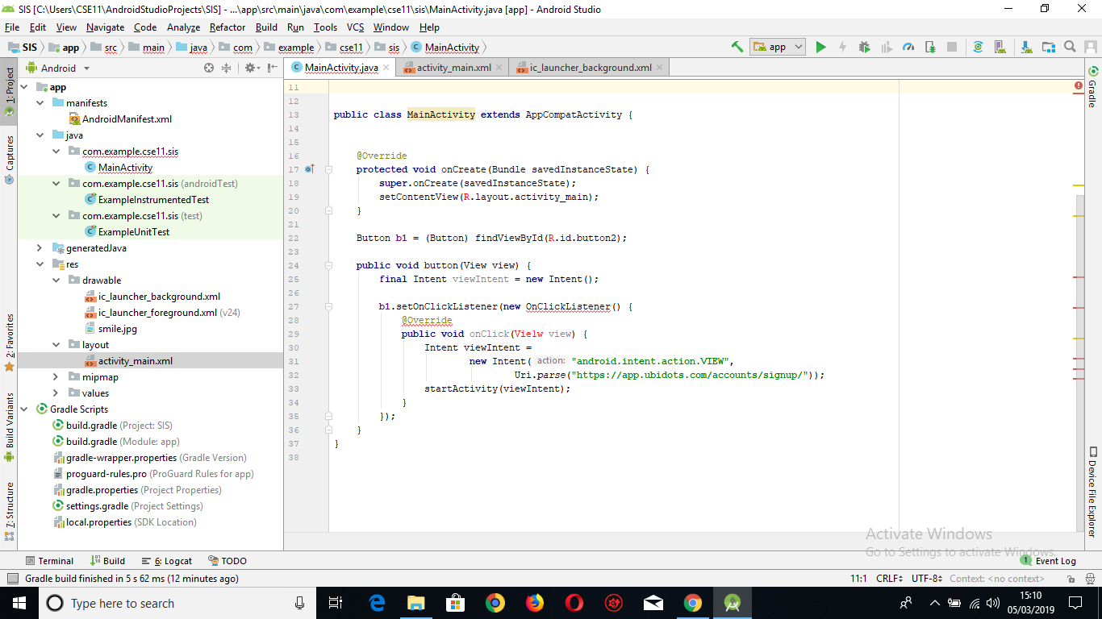
JAVA CODE

Slide 22
References:
http://www.ijirst.org/articles/IJIRSTV3I10005.pdf
https://ijarcce.com/upload/2017/july-17/IJARCCE%2027.pdf
https://observant.zendesk.com/hc/en-us/articles/208067926-Monitoring-Soil-Moisture-for-Optimal-Crop-Growth?mobile_site=true
https://www.pantechsolutions.net/smart-irrigation-system-using-iot-2381

Slide 23
Thank you
Queries
?

